Slide 1
PELVIS AND HIP
Benoit Hainaux, Eric Lévêque
Nathalie Chemla
Paris V Clinic France

Slide 2
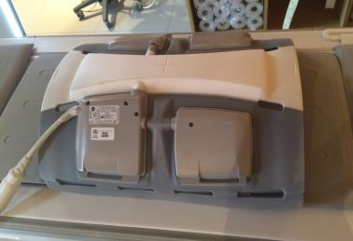
COIL
Phased array, abdominal type
If unilateral examination, large flex coil type
Notes:
This coil works with the table included coil as posterior element
Maintained with velcro strips
Large flex coil will offer you a better SNR but keep in mind that our patient mustn't be too large, or you will have not enough signal deeply

Slide 3
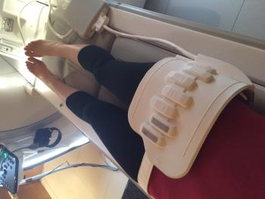
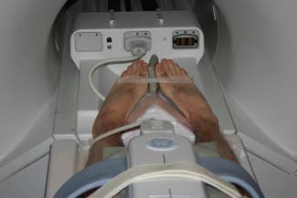
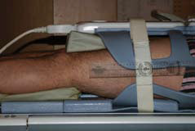
PATIENT POSITION
Lying on the back
Feet turned inside (45°) maintained with adhesive tape
Legs raised
Notes:
to put femoral neck in coronal plane
Legs raised with pads in order to horizontalize diaphysis

Slide 4
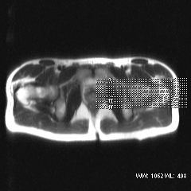
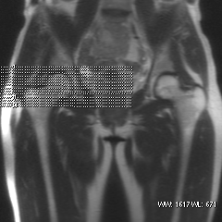
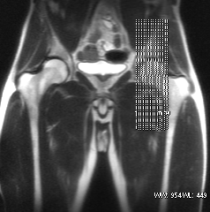
SLICES POSITION
Coronal plane
Axial plane
Sagittal plane
Notes:
Coronal plane : parallel to femoral neck and cover the femoral head
Axial plane : from acetabular roof to greater trochanter
Sagittal plane : from acetabular medial wall to middle femoral neck

Slide 5
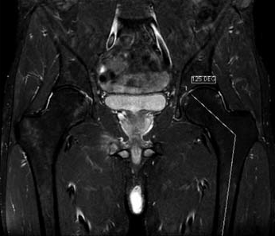
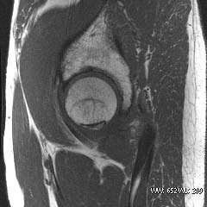
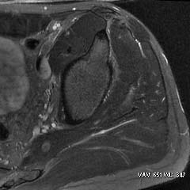
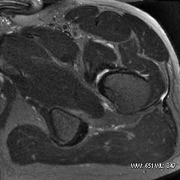
CRITERIA OF SUCCESS
gm
Notes:
Femoral head, neck and diaphysis in the same coronal plane, and measure the angle between neck and disphlysis
From acetabular roof to gluteus medius insertion in axial plane
Profil view of femoral head and good analysis of anterior and posterior labrum

Slide 6
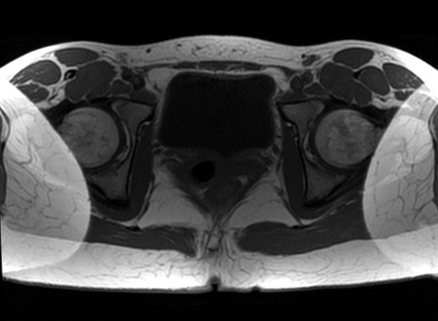
PHASE WRAP-AROUND ARTIFACT
Occurs when object dimension exceed the FOV
Phase encoding direction
Notes:
It is easily recognized as a folding over of anatomic parts into the region of interest

Slide 7
PHASE WRAP-AROUND ARTIFACT
Manifestation of aliasing phenomenon
Phase encoding
FOV
-90°
O°
360°
450°
Notes:
Aliasing is erroneous assignment of signal frequencies. On phase-encode direction, spins are encoded by their phase shift, from 0° to 360°. Beyond the FOV, spins posses phase shift less than 0° or greater than 360°

Slide 8
PHASE WRAP-AROUND ARTIFACT
Manifestation of aliasing phenomenon
Phase encoding
FOV
1°
90°
361°
450°
361-360 = 1°
450-360 = 90°
Notes:
Then, a spin who posses a 361° phase shift will be assigned to the spatial position of 1°, a spin who posses a 450° phase shift will be assigned to the spatial position of 90°

Slide 9
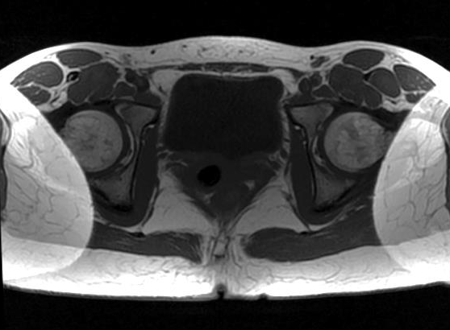
PHASE WRAP-AROUND ARTIFACT
Manifestation of aliasing phenomenon
L
R
Notes:
Left side of the patient is wrapped around the right side, and a same process wrap the right side around the left side

Slide 10
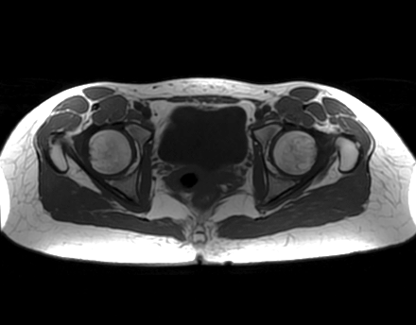
PHASE WRAP-AROUND ARTEFACT
Solutions
Increase the FOV
Phase encoding
Phase encoding
Notes:
The simplest solution is to increase the FOV to encompass the entire object dimension in phase-encode direction, but you will loose spatial resolution

Slide 11
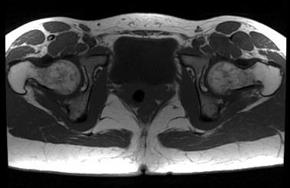
PHASE WRAP-AROUND ARTIFACT
Solutions
Use phase oversampling
Phase encoding
OVERSAMPLING
OVERSAMPLING
O°
360°
Notes:
Phase oversampling increase the sample in the phase-encode direction, and only reconstruct the FOV.
Acquisition time increase proportionally to the sample rate (max is 100% of FOV), but you don’t loose spatial resolution.

Slide 12
PHASE WRAP-AROUND ARTIFACT
Solutions
Swap phase-frequency encode direction
Phase encoding
Phase encoding
Notes:
Swap phase-frequency encode direction so that the FOV dimension in the phase axis encompass the entire object
Be careful of flow motion artifact, which spread in the phase-encode direction (for example, femoral artery on the hamstring muscle)

Slide 13
WHAT DO YOU SEARCH?
Coxofemoral arthropathy ?
Tumoral lésion?
Periarticular pathology?
Tendinitis?
Sacroilliitis?
Always begin with bilateral anatomic coronal study (FSE T1)
Notes:
Now that you have the good technic to do it, the way you will perform the exam depends on what you surch exactly

Slide 14
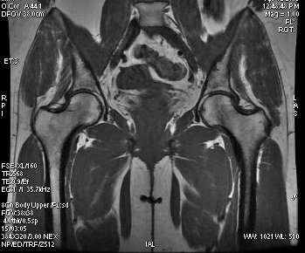
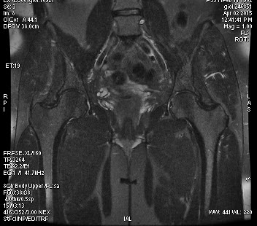
BILATERAL COMPARATIVE STUDY OF THE PELVIS
FRFSE T2
FSE T1
ANATOMIC SEQUENCE
Notes:
INHOMOGENEITY OF the edgeTHE FIELD INT2 sequence because it is fr fse and not stir
But in this case iti is ok to do frfse because patient not fat and image of frfs has beetre qualituy than stir
In fat patient or people with big muscle it woul have been better to use stir sequence to avoid inhomogeneite of field

Slide 15
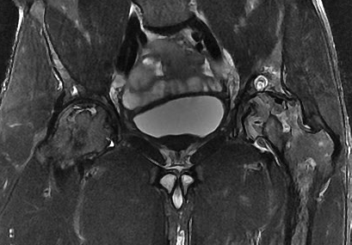
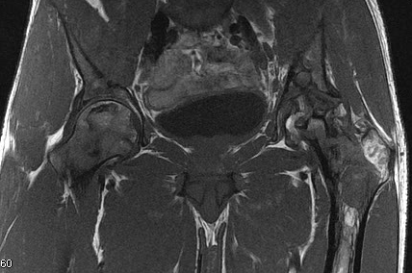
BEGINING: BILATERAL ESPECIALLY IF YOU SUSPECT ASEPTIC OSTEONECROSIS OF FEMORAL HEAD
This patient had unilateral pain and as often bilateral lésions

Slide 16
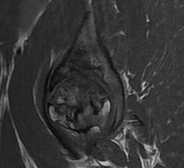
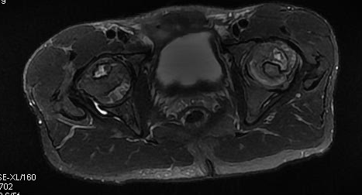
SAG FSE T1
AXIAL BILATERAL FSET2

Slide 17
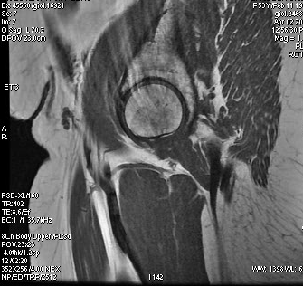
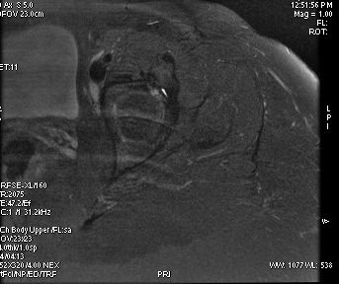
MOTION ARTIFACT
WE SHOULD HAVE USED STIR AND PROPELLER
Notes:
Do not forgrt to use propeller to avoid motion artifact annd flow

Slide 18
UNILATERAL STUDY OF THR HIP
IF you look for localized disease
Most often when you whant to study
Catilaginous defect (MR arthrography)
Labrum pathology ( MR arthrography)
Patient with controlateral total hip remplacement
MR arthrography ++++ ( better than MRI without intrarticular Gadolinium)
Notes:
If you look for more localized specifique deases

Slide 19
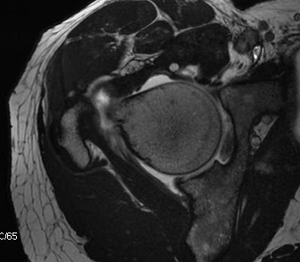
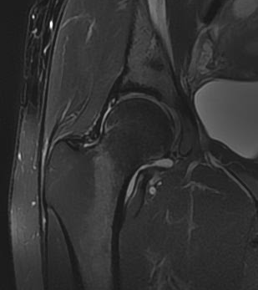
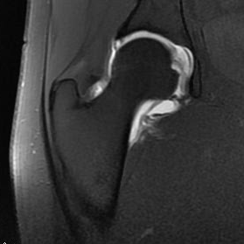
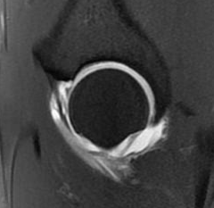
MR ARTHROGRAPHY OF THE HIP
Notes:
T1 with or without fat sat
fiesta

Slide 20
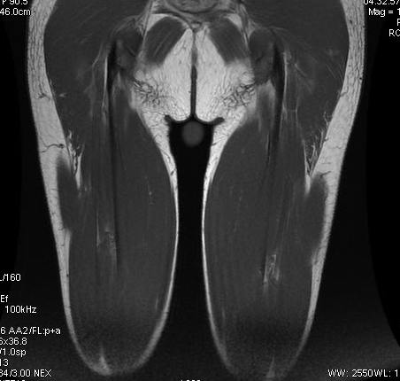
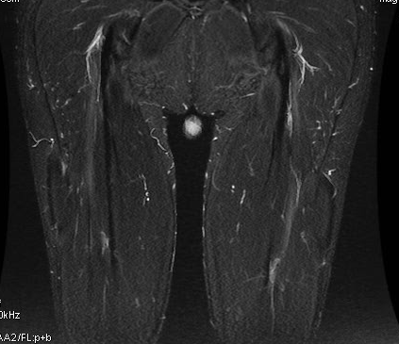
HAMSTRING MUSCLES
⬅
T1 SE , GOOD FOR ANATOMIC STUDY OF HAMSTRING MUSCLE
FSE T1
STIR
GOOD DIFFERENTIATION
BETWEEN NORMAL AND PATHOLOGIC
TENDONS AND MUSCLES
➔
STIR
Notes:
You can apply this technic to hamstring muscle
The insertion of the hamstring muscle in the ischion tuberosity is well seen
Use the same method as hip

Slide 21
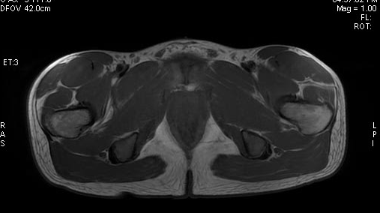
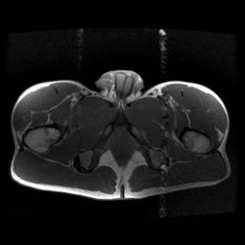
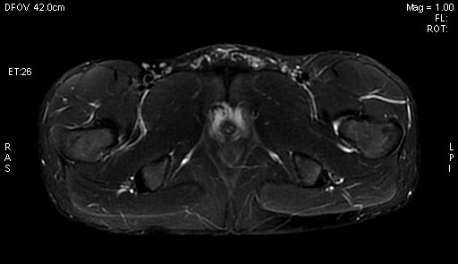
FSE T1
STIR PROPELLER
NO MORE FLOW ARTIFACT
WITH PROPELLER
Notes:
You will prefer promote stir and propeller

Slide 22
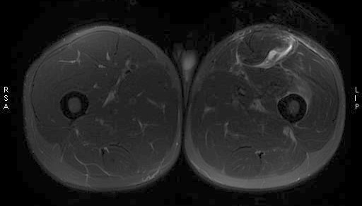
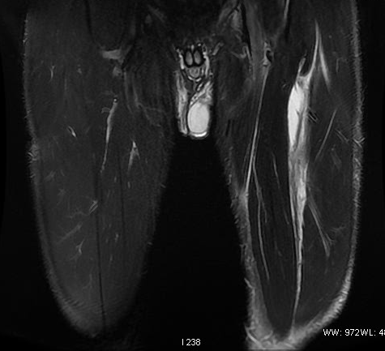
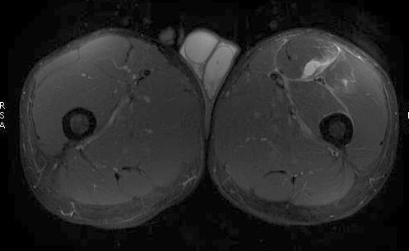
THIGH MUSCLE STRAIN
STIR
FAT SAT
Notes:
Verifier les sequences

Slide 23
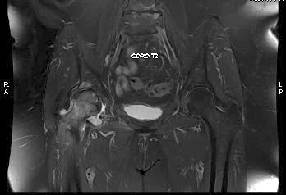
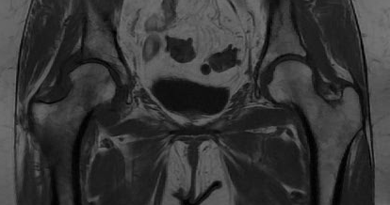
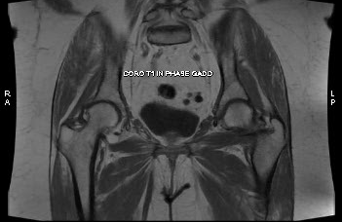
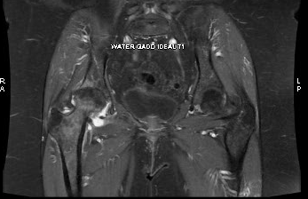
STRESS FRACTURE OF THE FEMORAL NECK
FSE T1
FSE T2
IDEAL AFTER GADO
Notes:
Parler de l inhomogeneite de sigal en fat sat versus ideal
Fluid effusion
The enhancment after intra vienous gado linium
Cancellous bone

Slide 24
TAKE HOME MESSAGE
Bilateral study++++
Unilateral +/- MR arthrography
T1
T2
STIR when fat people and when fat sat inhomogeneous
Propeller
Notes:
Promote stir

