Slide 1
HOW I DO IT: SPINE IMAGING
Benoit Hainaux, Eric Lévêque
Nathalie Chemla MD
Paris V Clinic
France

Slide 2
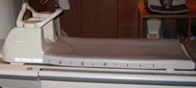
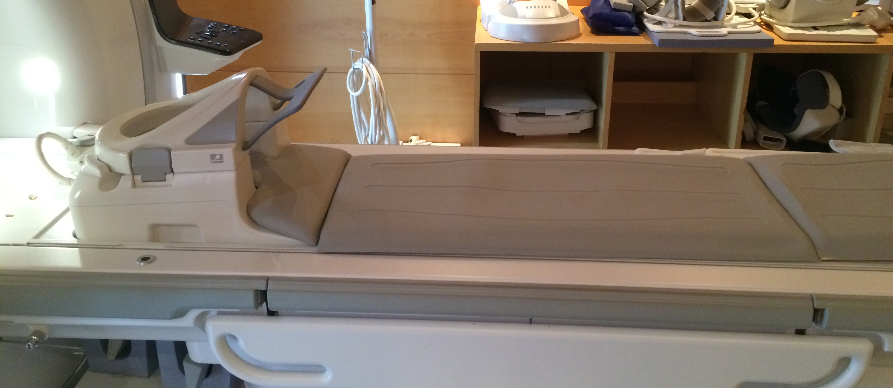
COIL
Dedicated phased array
Or table integrated coil
Anterior element if cervical

Slide 3
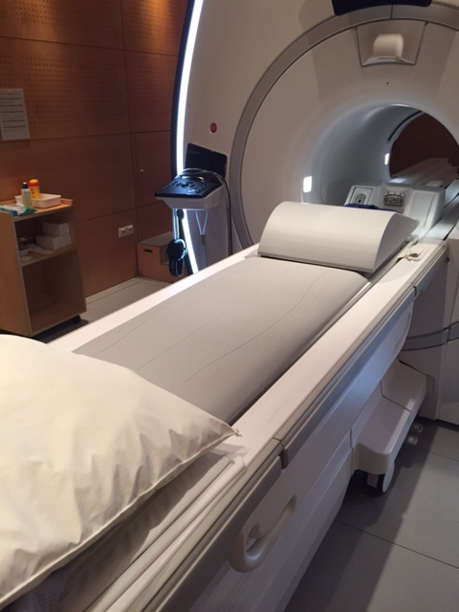
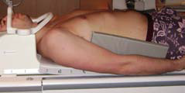
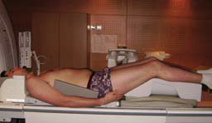
PATIENT POSITION
Lying on his back
Arms along the body
Feet first with integrated coil
Notes:
Put foam pads between the arms and the body to avoid brun hazard by creating an electrical loop
Legs must be uncrossed for the same burn hazard problem, and avoid patient motion if he wants to uncross during the examination. You can of course ask for it for all others examinations.
Put a cushion under the legs to decrease lumbar lordosis.
Ask for slow breathing, and avoid swallowing if cervical.
With table integrated coil, it is possible to perform feet first position in routine, which is much more comfortable for patients

Slide 4
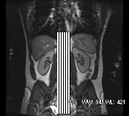
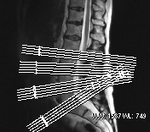
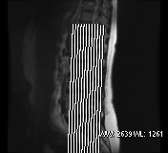
SLICES POSITION
Sagittal plane
Axial plane
Coronal plane
Notes:
Sagittal plane : middle slice must be in the middle of spinal cord or canal and cover the neural foramens on each sides
Axial plane : 4 or 5 slices leaned in the axis of intervertebral disc in double obiquity, on the 4 lasts discs most of the time, of course you can adapt according to disc disease seen in the sagittal plane. If you work with 3D axial spin echo, lean the acquisition box in a average axis of the discs to have better reformat quality.
Coronal plane : on sagittal plane, cover the spine back and forth, from last dorsal spine to femoral head up and down if lumbar.
Put a presat to avoid vascular (with aorta ot heart), breathing or flow motion artifacts

Slide 5
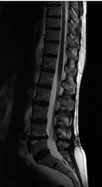
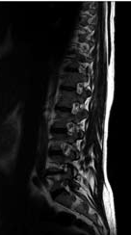
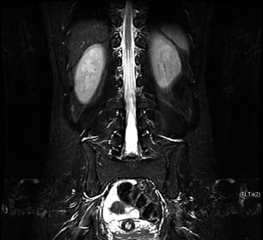
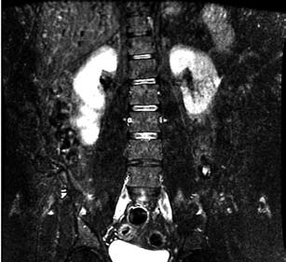
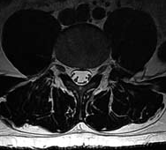
CRITERIA OF SUCCESS
Notes:
Visualization of spinal cord and neural foramens covered laterally in saggital plane
Analysis of intervertebral disc and neural foramens in axial plane
Analysis of paravertebral structures in coronal plane (sacroiliac joint and femoral head for lumbar spine)
No vascular, breathing or flow motion artifacts

Slide 6
HOW I DO IT: SPINE IMAGING
SAGITTAL SEQUENCES
To differentiate T1 and T2 Sagittal SE images
Two principal marks:
CSF (signal of water) +++
Fat tissue
CSF
HYPO T1
HYPER T2
FAT
HYPER T1
HYPER T2

Slide 7
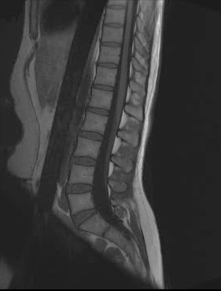
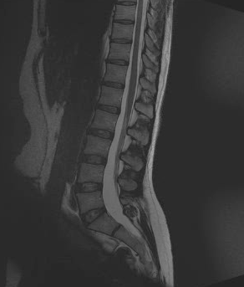
CSF: HYPO T1 HYPER T2
T1
T2
FAT: HYPER T1 HYPER T2

Slide 8
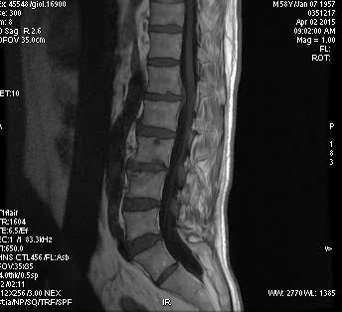
T1 SAGITTAL SEQUENCES
Black CSF
White FAT
Short TR
Short TE
Always done in sagittal plane
Very good visualisation of anatomy
Important +++ bone marrow evaluation

Slide 9
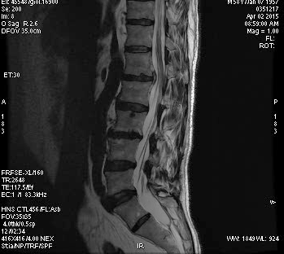
T2 SAGITTAL SEQUENCES
WHITE LIQUID best sign++++
LONG TR
LONG TE

Slide 10
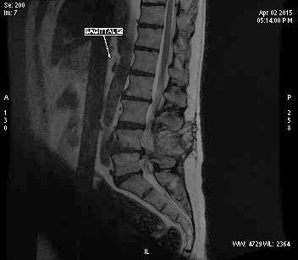
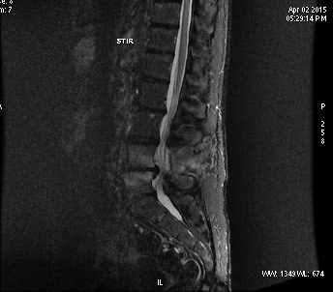
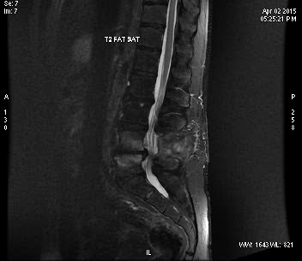
FSE T2 USED IN MOST CASES OF SAGITTAL SEQUENCES IN DEGENERATIVE DISEASE
STIR CAN BE USED IN TUMORAL DISEASE AND INFLAMMATORY PATHOLOGY (MODIC)
FSE T2
FAT SAT T2
STIR
Notes:
TOU WILL PREFERE stir to fats at T2 in case of tumoral or inflammatory disease because of the risk of inhomogeneity of fat sat

Slide 11
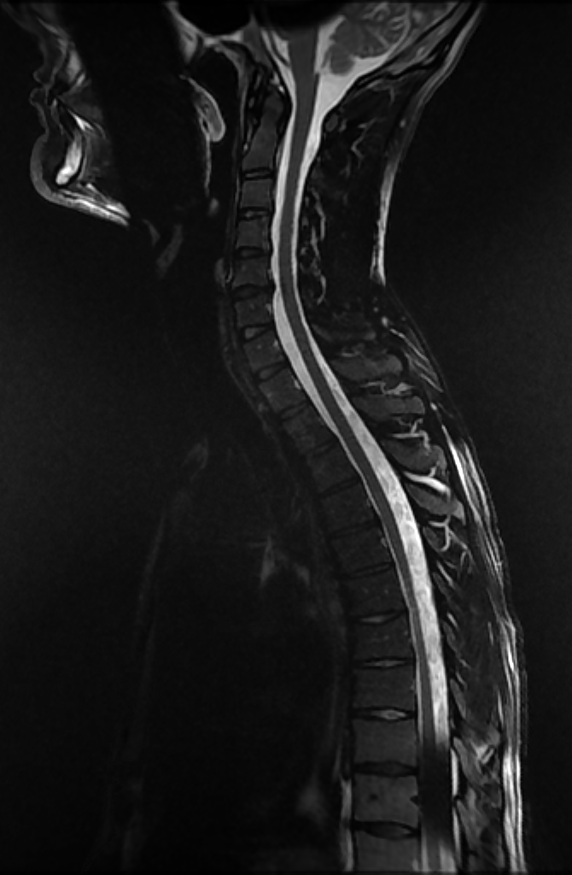
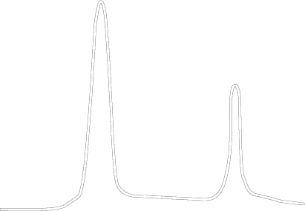
FAT SAT PROBLEMS
With large FOV or anatomy prone to susceptibility, fat sat is not efficient
Signal
Water
Fat
Precession
frequency
Notes:
If you use large FOV, for a dorsal and lumbar spine T1 FS with gadolinium injection for exemple, you will have fat sat problems at the border of the FOV. You have also this problem if the area is not homogeneous, like cervical spine with lot of air and tissus in the Fov (same problem with ankle)
Because of less magnetic field homogeneity, fat and water peak are displaced. So MRI will not be able to cancel the right fat peak, and you will have fat sat defaults.

Slide 12
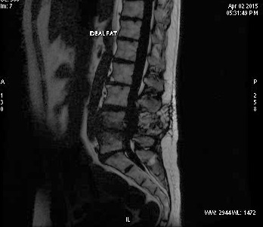
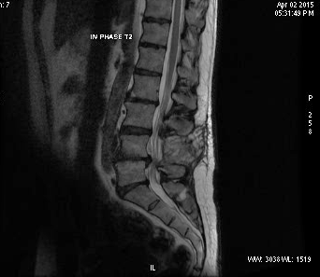
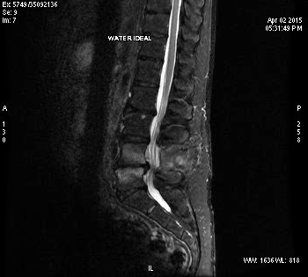
IDEAL
IMAGES WITH AND WITHOUT
FAT SAT IN THE SAME SEQUENCE
IS ALSOW USEFUL AFTER INJECTION
Notes:
Avoid defaut fat sat

Slide 13
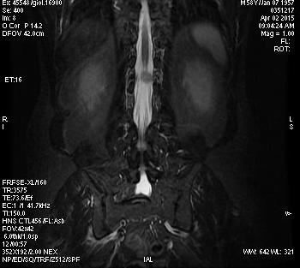
CORONAL STIR FR FSE
Coxofemoral joint
Sacro iliac joint
Tumoral and inflammatory pathology
STIR/ big FOV

Slide 14
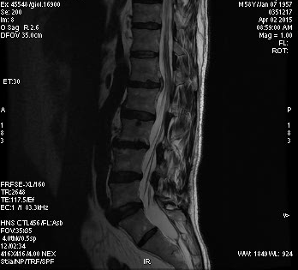
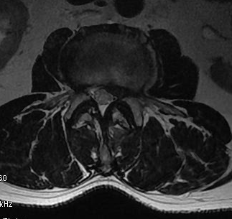
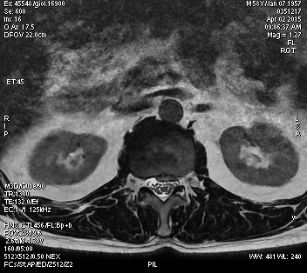
AXIAL VIEWS: SE T2 / CUBE T2 REFORMAT

Slide 15
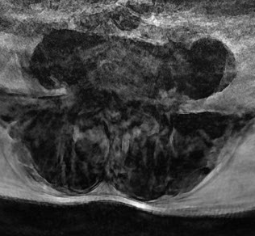
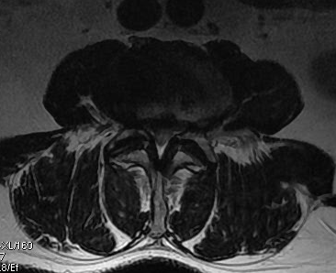
MOTION ARTIFACT
AXIAL CUBE REFORMAT
AXIAL DIRECT ACQUISITION

Slide 16
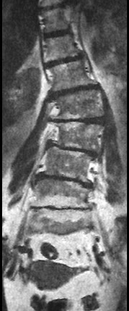
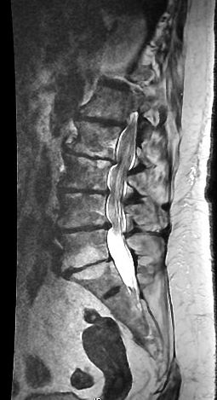
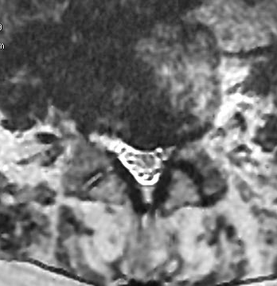
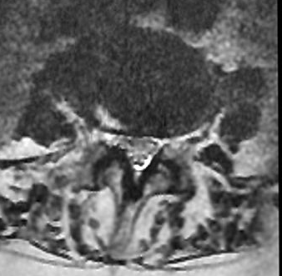
CUBE
Notes:
Good analysis googd slice in the axis of the disk

Slide 17
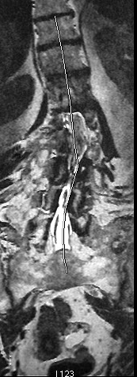
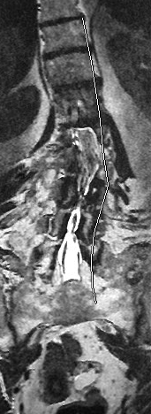
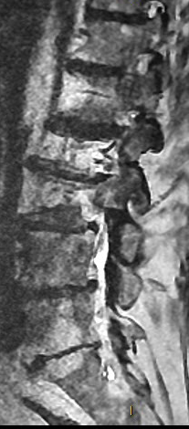
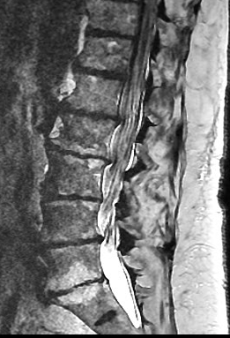
Notes:
Sagittal reformat in the axis of the spinal cord

Slide 18
TAKE HOME MESSAGE
SE T1
FSE T2
STIR
CUBE
IDEAL
The choice depends of the pathology

